Slide 1
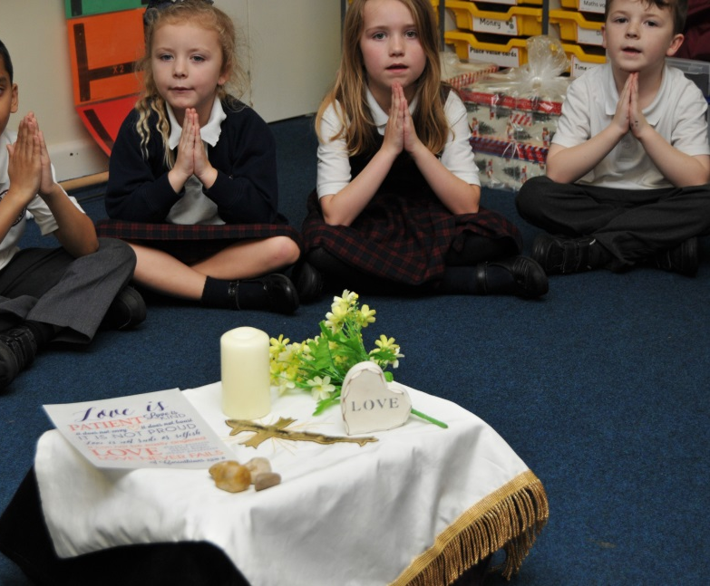
Celebrating our new Mission Statement

Slide 2
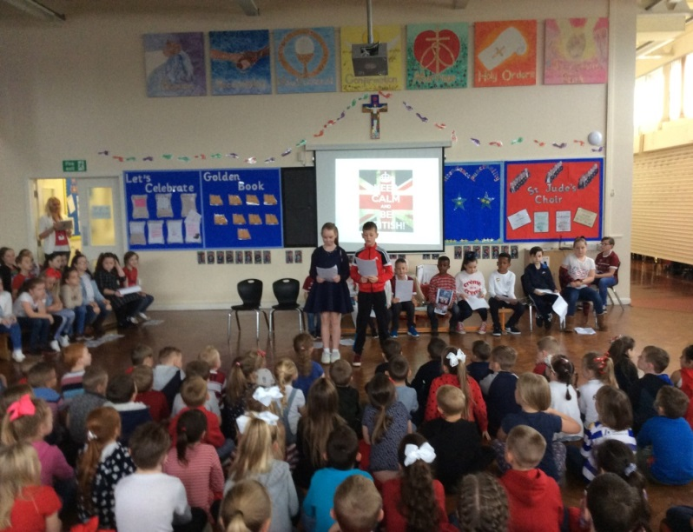
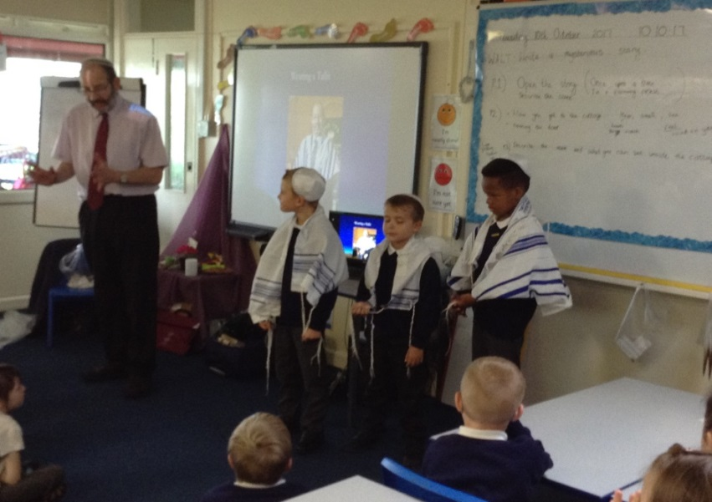
Our aim is
To be a Christian family bringing the Gospel to life by word and example

Slide 3
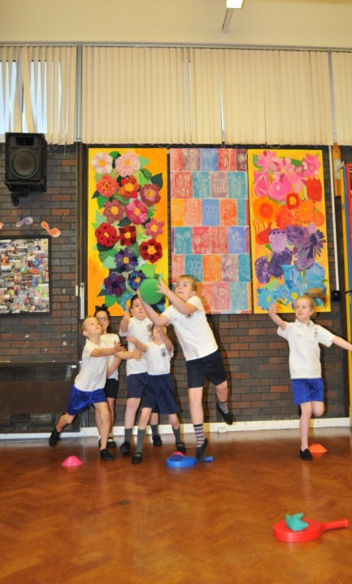
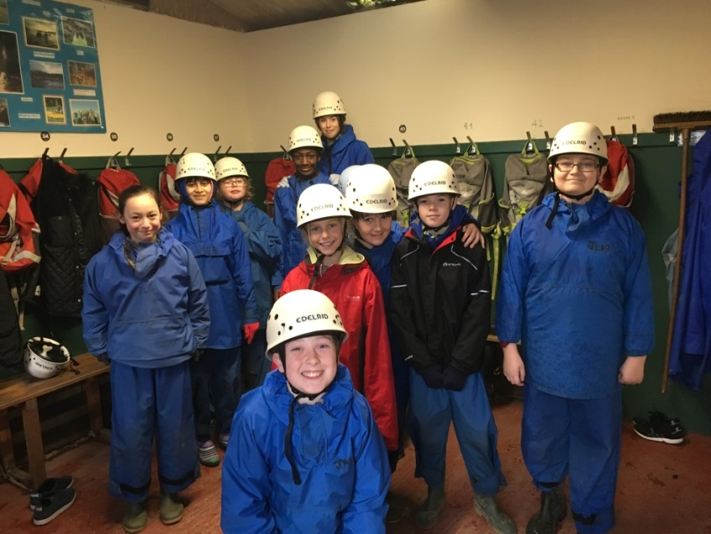
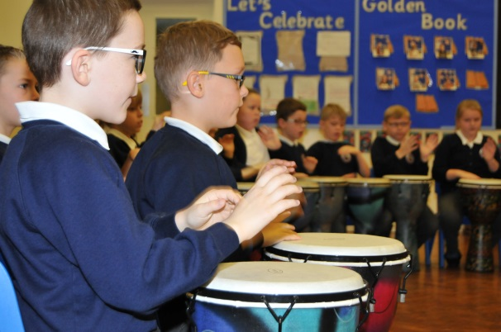
Our aim is
To nurture and inspire each individual so that we can learn and grow in order to reach our full potential

Slide 4
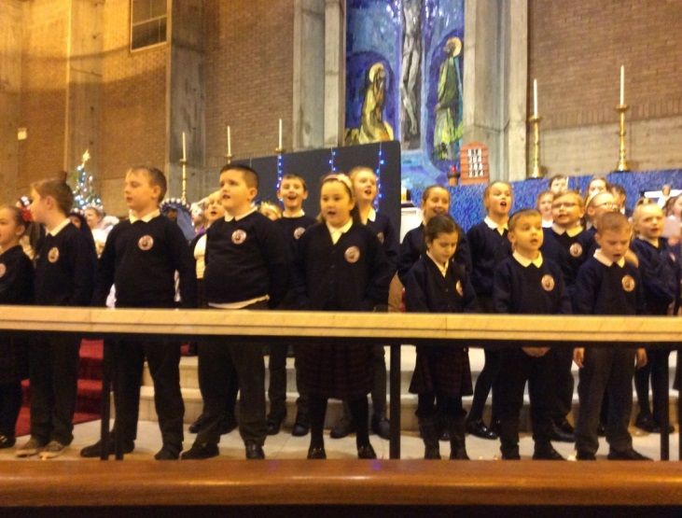
Our aim is
To develop, maintain and strengthen relationships between school, church, home and wider community.

